Slide 1

FOOD CONSUMPTION IN INDIA SANDRINE PREVOT
DAFT NOV21
FEB, 11th | PARIS

Slide 2
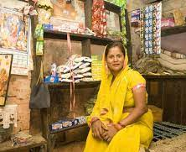
Business case
Domain: Consumer behaviour in India
Analyze the indicators which measures food expenses in taking into account their link with social background. It will permit a better understanding of the consumer, of the quality of life and responsiveness of demand.
Keep in mind: there is a political issue: in a context of Hindu nationalism, the religion and casts is used for political purposes in order to divide Indians (the stigmatization is based food consumption)
The objective of the project is to see whether social characteristics determine consumption behavior or not.

Slide 3
Process
About data
Socio-Economic/Monitoring Survey of NSS
Title: India - Household Consumer Expenditure, NSS 68th Round : July 2011 - June 2012
(Expenditure during 1 month)
From : National Sample Survey Office - Ministry of Statistics and Programme Implementation(MOSPI),Government of India.
Data Loading
Data cleaning
EDA
Encode non-numeric data
Clusters Investigation
Model Evaluation
Model implementation

Slide 4
Data cleaning and preprocessing
1. Three datasets:
Household: Shape (101662, 45) + Shape (101662, 39)
Food expenditure: Shape (5763152, 35)
2. Build a unique dataset:
Merge on Household ID and features selections: Shape (100497, 33)
7 columns non-numeric – 26 columns numeric (1 ID, 9 on household and 23 on food)
3. Cleaning
Rename labels of columns
Build a new classification with filter on food items
Check for duplicates/ missing value
Exclude outliers in each numeric column
Drop rows with small numbers of household (ex: 'Zoroastrianism’, only one household)
Check collinearity

Slide 5
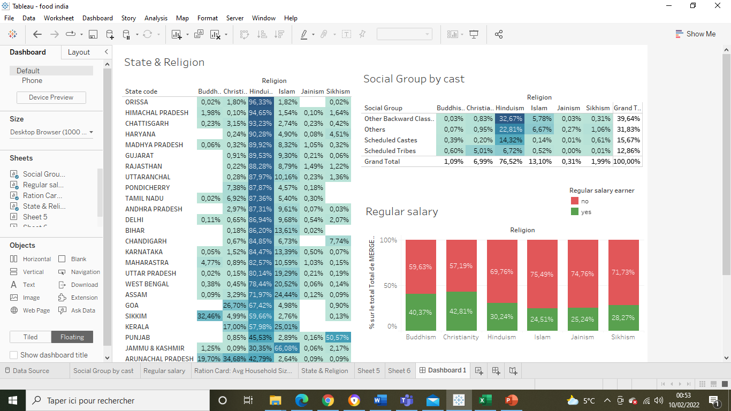
EDA
OBC
Scheduled Castes
Scheduled Tribes
Communauties in these administratives divisions benefit of the positive discrimination policy ( Quotas in public employment and high School – 50% of places and job)
Others:
Communauties advanced socially and economically

Slide 6
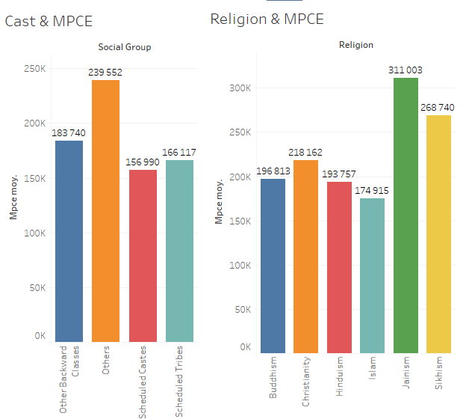
EDA
Monthly Per Capita Consumer Expenditure (MPCE)

Slide 7
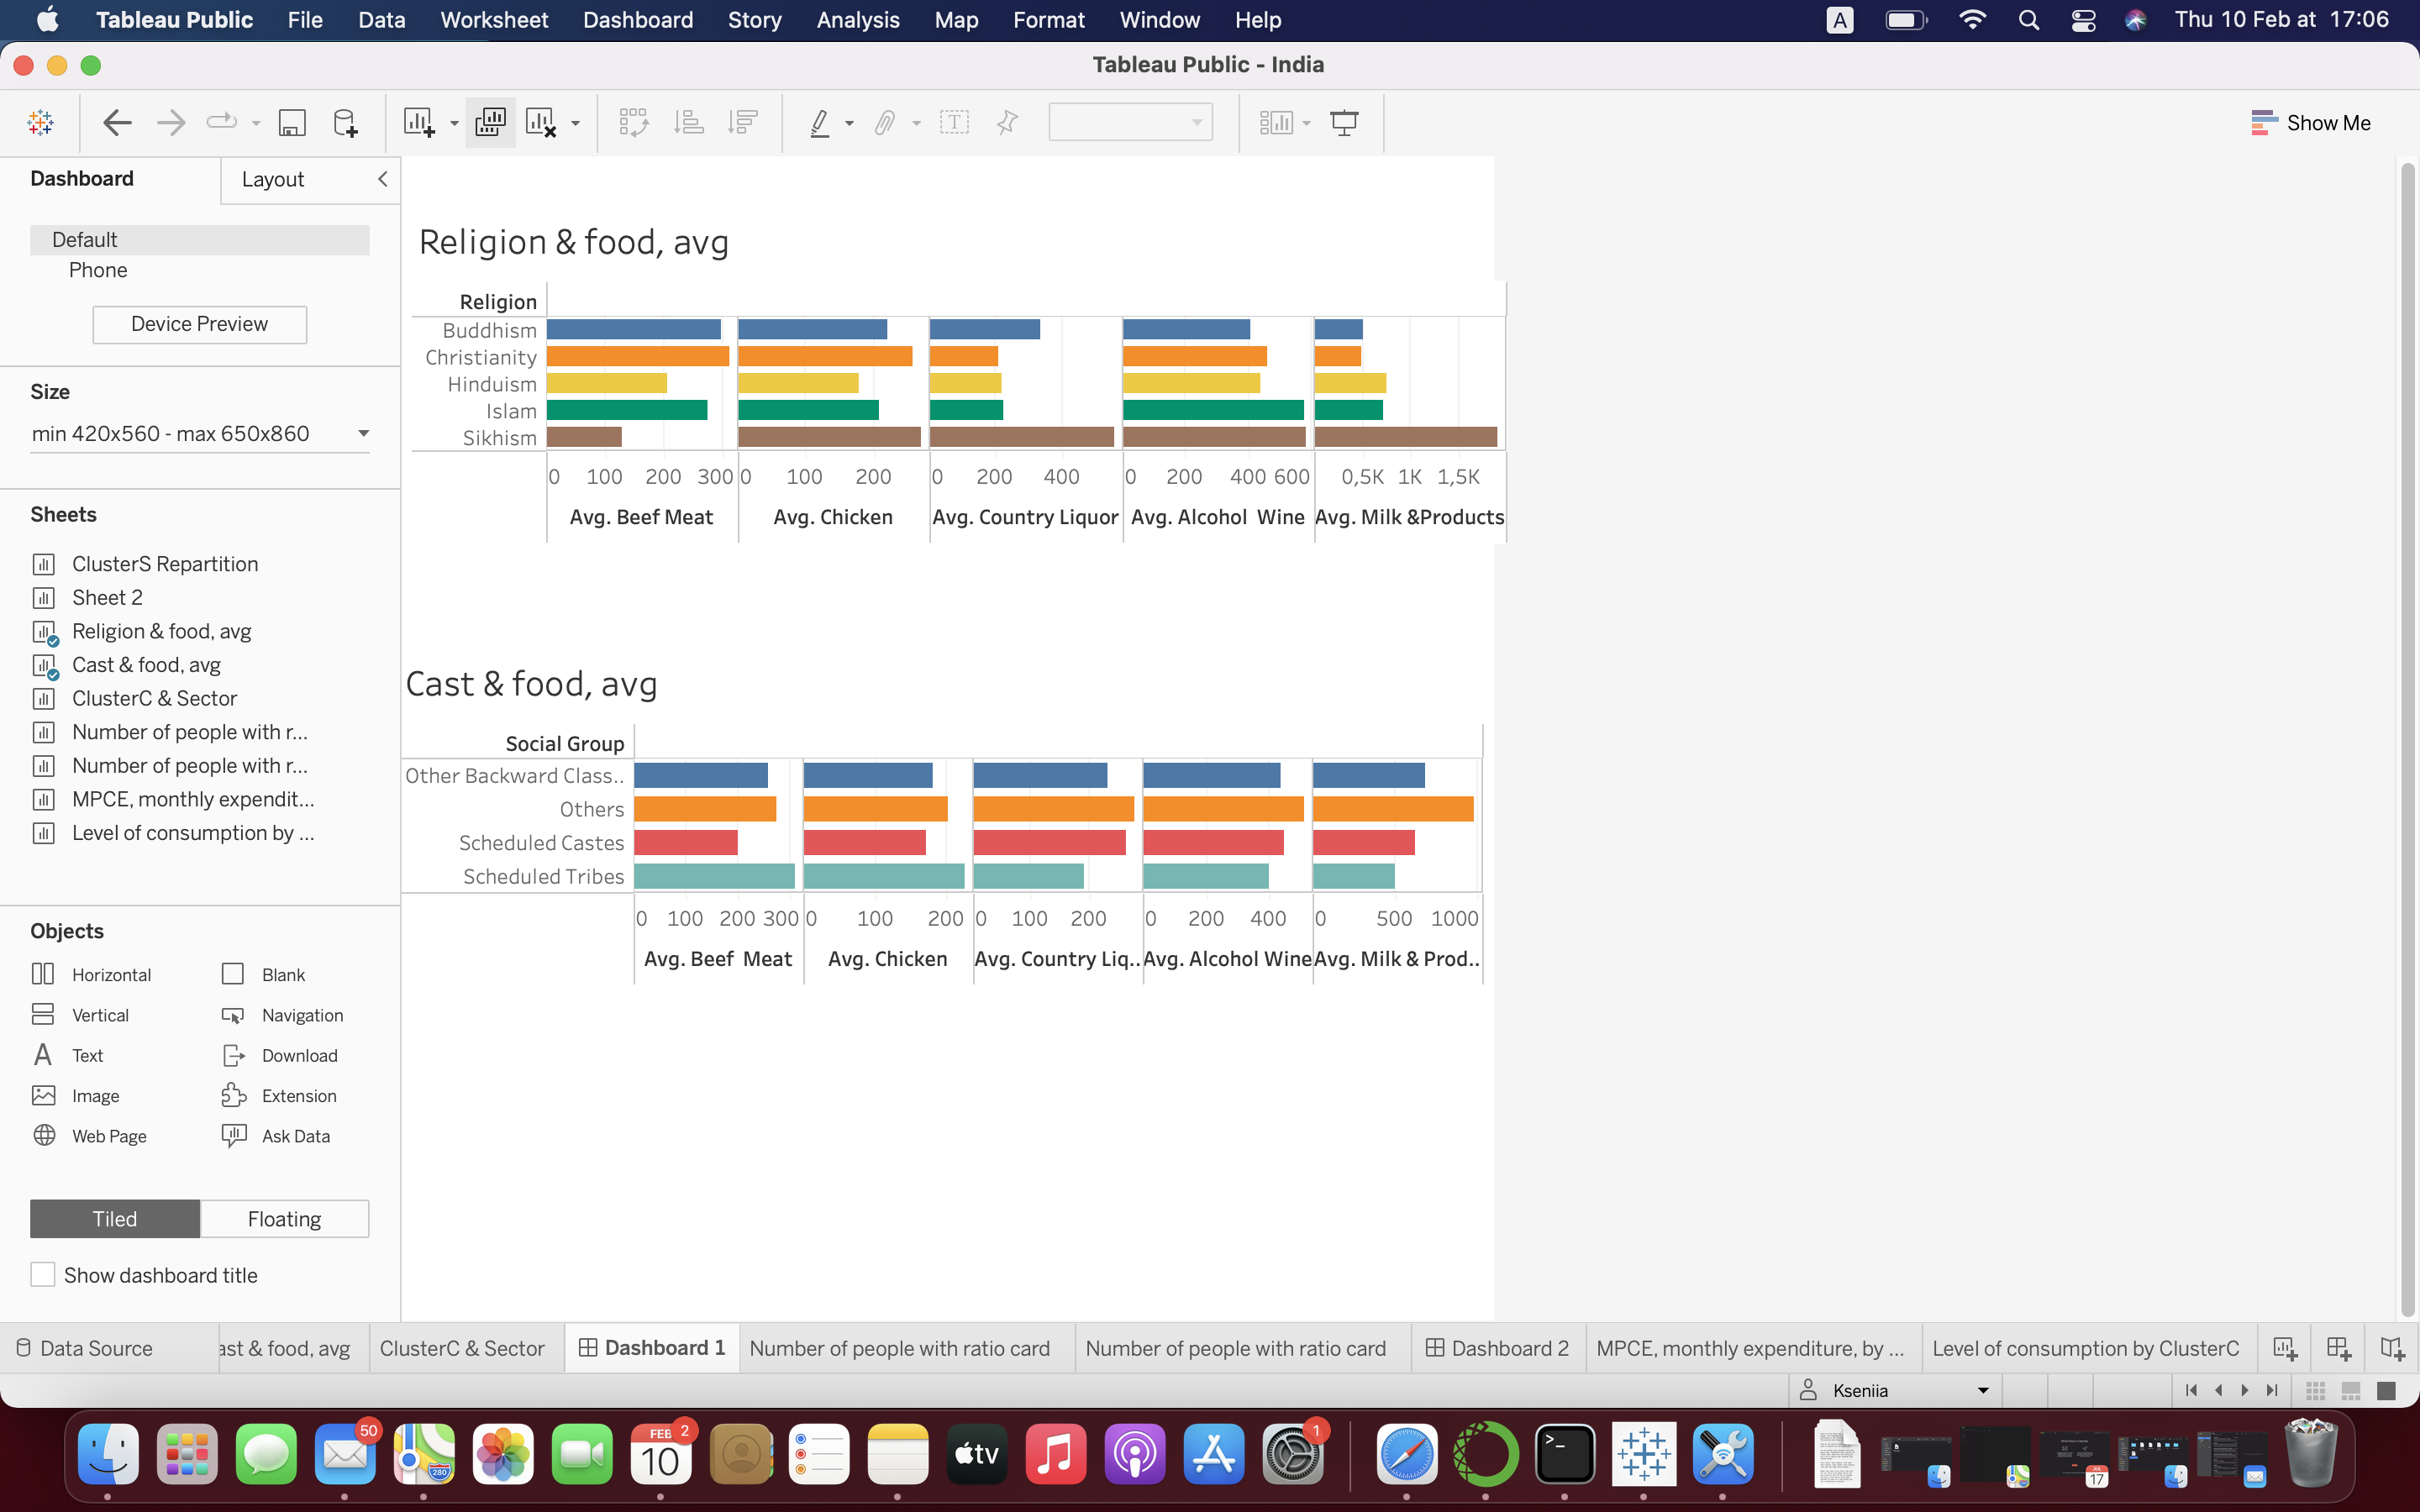
EDA

Slide 8
UNSUPERVIZED MODEL - KMEANS
24 columns to cluster
PCA:
Principal Component Analysis (PCA) is used for dimensionality reduction in machine learning.
PCA is used to filter noisy datasets, such as image compression.
KMEANS: Unsupervised machine learning algorithms
k-means clustering tries to group similar kinds of items in form of clusters. It finds the similarity between the items and groups them into the clusters.
K-means clustering algorithm works in three steps:
Select the k values.
Initialize the centroids.
Select the group and find the average

Slide 9
Models evaluation
Models | Optimum of clusters | Score Silhouette
KMEANS KElbowVisualizer(k = (2,5), metric='silhouette') | 2 | 0,623
AGGLOMERATIVE MODEL KElbowVisualizer( k = (2,5), metric='silhouette') | 2 | 0,561
GAUSSIAN MIXTURE (range (2,6)) | 2 | 0.620
DBSCAN MODEL (eps in range (1,5)&min_samples in range (2,5)) | 2 ( or 68) | -0.170 ( or -0.939)

Slide 10
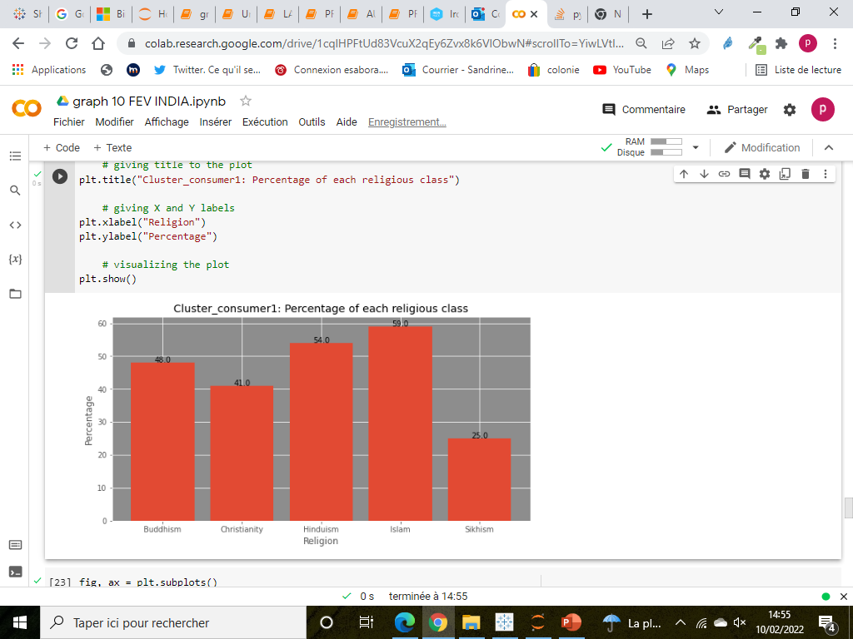
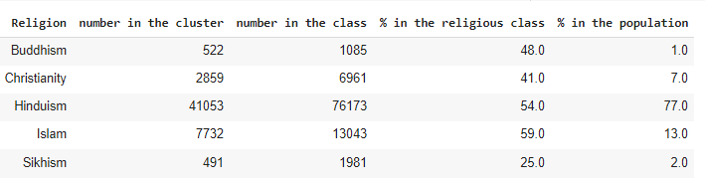
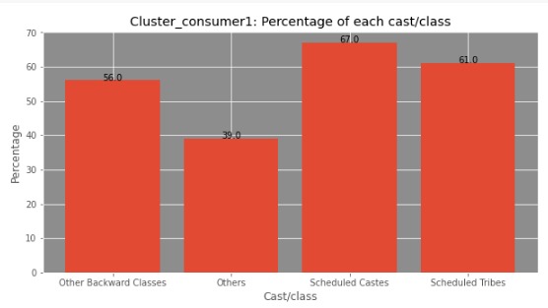
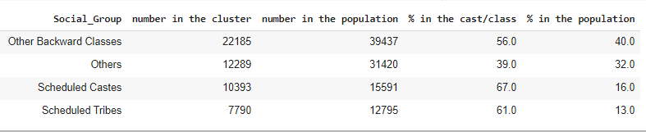
Main results
CLUSTER 1
Insights:
More Scheduled Castes & Tribes (respectively 67% and 61%) (and Others mainly in cluster0)
More Muslims (59% of muslims in cluster1)

Slide 11
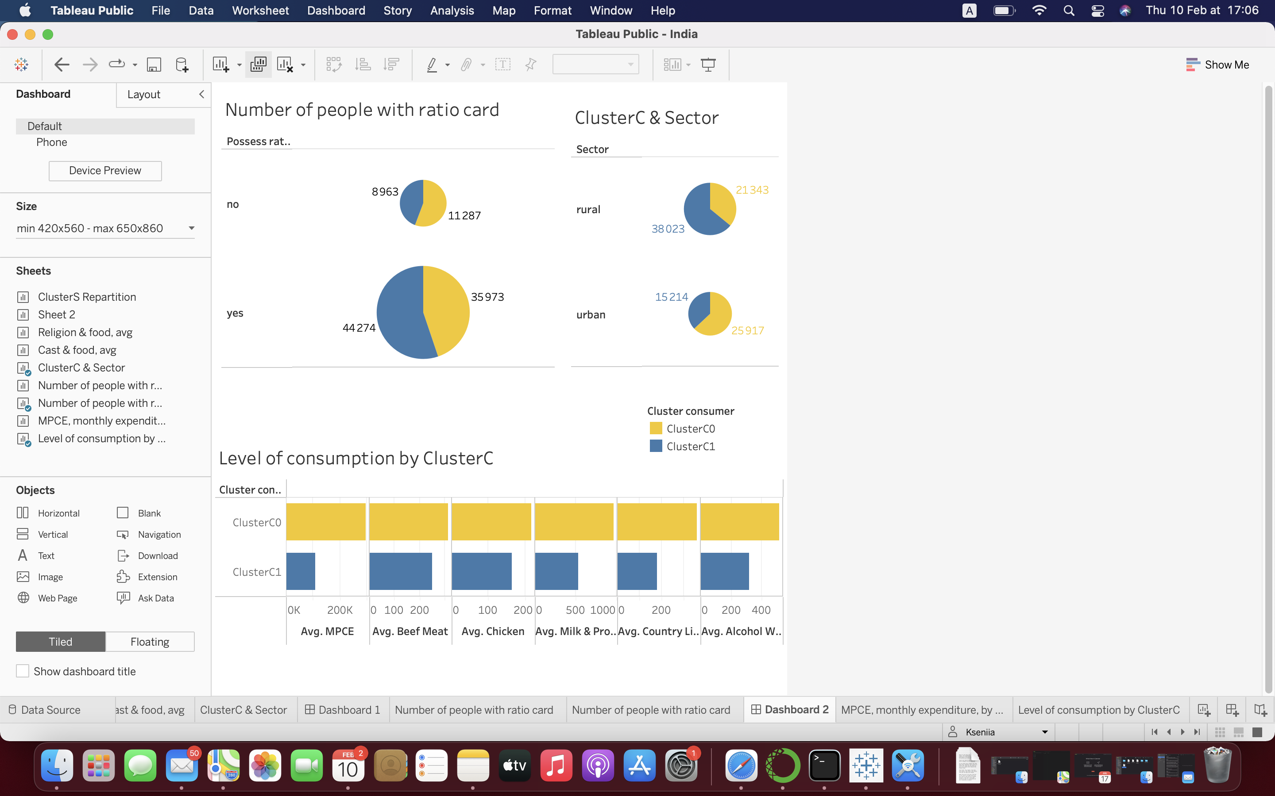
Main results
Cluster1: less money, less food,
More rural, with ration card

Slide 12
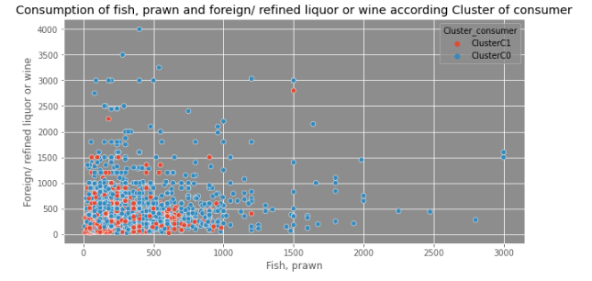
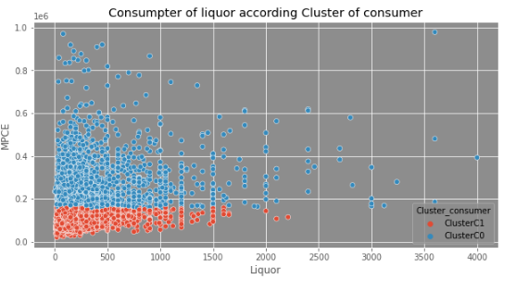
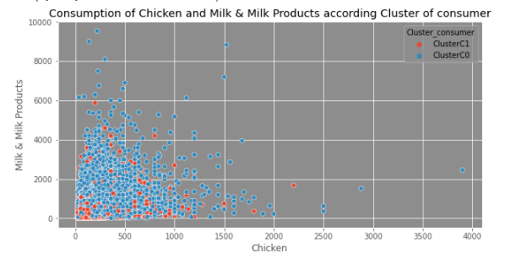
CONCLUSION
The main difference seems to be based on level of revenue.
Religion & cast are not a criteria of food consumption –
we can’t not affect special food to a religion/a cast, independently of revenue
But the poorer and the one who eats less is majority from scheduled caste, Tribes, have islam as religion and lives in rural sector
➔ There is no difference of the structure of food consumption related on religion/cast values

Slide 13
FOOD CONSUMPTION IN INDIA
SANDRINE PREVOT
Q&A?

